Slide 1
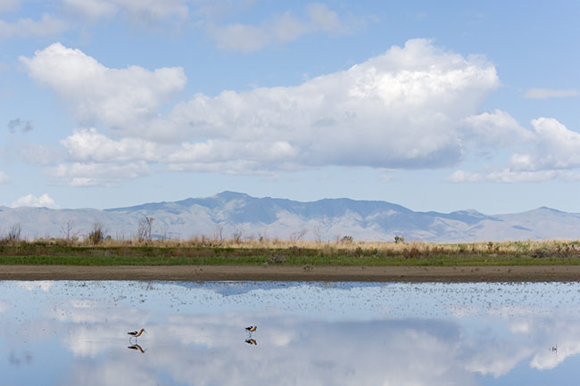
Bear River Migratory Bird Refuge
Evaluation of River Basin Management Alternatives
Bryce Mihalevich¹, Tyler Pratt²
Civil and Environmental Engineering MS, USU
CEE6490 Integrated River Basin/
Watershed Planning and Management
4/28/16
1: bryce.mihalevich@aggiemail.usu.edu
2: tyler.pratt@aggiemail.usu.edu

Slide 2
Outline - Update
Overview
Objectives
Challenges
Performance Metrics
WEAP Scenarios
WEAP Results
Discussion
Conclusions
Q&A

Slide 3
Overview of the Bear River Basin and Class Stakeholders
PacifiCorp
Bear River
Canal Company
Logan City
Bear River
Migratory Bird Refuge

Slide 4
Objective of the BRMBR
Foster priority bird species occupation
This requires . . .
Supplying and managing target wetland water levels
Recovering and enhancing plant and wildlife values
Maintaining dikes and levees

Slide 5
Current Water Challenges
Unreliable summer flows

Slide 6
Performance Metrics for the BRMBR
Weighted monthly bird use
Monthly basis
Maximize result
Reliability
Monthly basis
Resilience
Monthly basis
Vulnerability
Monthly basis
Notes:
This metric creates a higher weight for months that have higher bird usage.
For example, April and May have higher priority bird species use than June and July or December and January, thus, when unmet demand occurs for higher weighted months, a greater negative effect on the performance metric is incurred.

Slide 7
Monthly priority species habitat use
U.S. Department of the Interior, Fish and Wildlife Service, Bear River Migratory Bird Refuge, Habitat Management Plan (2004). Table 6.

Slide 8


Weighted Monthly Bird Use Performance Metric Calculation
${Weight of Month}_{t} ({WM}_{t})= \frac{{MSU}_{t}}{\sum{MSU}}$ [1]
$Weighted Bird Use Metric= \sum{(\frac{{Demand}_{t}−{Unmet Demand}_{t}}{{Demand}_{t}}∗{WM}_{t}})$ [2]
where:
t - monthly time step
MSU – Monthly Species Use, the number of priority species present across all habitats within a given month

Slide 9
WEAP Model Scenarios
New “Above Cutler” Reservoir
Release Policy
Flood storage in Apr, May, Jun
Top of inactive 2000 ac-ft
Buffer coefficient of 1
Hyrum Reservoir Storage Addition
Increase storage capacity by 50,000 AF
Urban Water Use Reduction
25% reduction for all M&I demand sites
Statewide goal by 2050
Notes:
Note that we changed our urban water use reduction from 15% to 25% (which is the statewide goal by 2050)

Slide 10
Tabular Results

Slide 11
Graphical Results

Slide 12
Conclusion
For all stakeholders . . .
Most beneficial alternative
New “Above Cutler” Reservoir
Second most beneficial alternative
Urban Conservation
Worst alternative
Hyrum Reservoir Storage Addition

Slide 13
Questions?

